Slide 1
BI Tool Selection Criteria
Using the right tool in the right situation

Slide 2
Stated Aim
To formalise a procedure for identifying the correct BI tool to utilise for any given future use case, that is concise and devoid of political influence and maximises cost benefit

Slide 3
Chosen Approach
For the purpose of simplifying the approach we will focus on the concept of DAR (dashboard methodology) which we will expand to DARs to include a self-service element:
D ashboard
A nalysis
R eport
S elf-service

Slide 4
DARs in detail
D ashboard
The Dashboard page gives just the most important information and has the least amount of interactivity/clicking. It is mostly to help users scan for status updates. If your users have only a minute or two to get the overall status of their business this is where they would do it. They can check in and see if things are working or not. It’s a starting off point, like a table of contents - you get an idea of what is available and then head off to other parts of the application based on what you have see here.
A nalysis
Analysis pages are more interactive, they help users explore their data and look for answers to questions they may have formed on the dashboard page. Analysis pages are where you come to spend more time and interact with the application on a deeper level to explore the data. Typically each page has a part of the business it is exploring or a specific technical objective (such as a page just for Comparative Analysis).

Slide 5

DARs in detail
R eport
Reporting pages give the most granular information with lots of tabular data and should ultimately lead to action. It’s where a user can spend a lot of time sorting and filtering through the details. This is a large part of the cognition phase of perception
S elf-service
Source: EDF Programme Team Update - 2 May 2018

Slide 6
The Toolbox
For the purpose of this activity the BI tools that are deemed in scope for consideration are:
Business Objects (Webi)
QlikView
QlikSense

Slide 7

Overlap
It is important to be clear that the tools that are now present in the tool kit represent a large amount of functional overlap and in many scenarios it would be possible to choose between any of the tools and still meet the users needs.
It should also be noted that the development road maps for the big players in the BI tool market place would seem to indicate a path to even greater convergence.

Slide 8
BI Tool Decision Trees

Slide 9

Requirement
The first stage in trying to discover whether the requirement sits as a Dashboard, Analysis, Report or Self-Service
Which decision tree should I follow
Yes
KPI’s
D ashboard
Yes
No
A nalysis
Visual
Requirement
Yes
R eport
No
Varying grain of data
Yes
S elf-Service
No
Tabular
Yes
Yes
Yes
Yes

Slide 10


D ashboard
The Dashboard page gives just the most important information and has the least amount of interactivity/clicking. It is mostly to help users scan for status updates.
Do the users what to see how they are performing based on a set of KPI’s
Want to use KPI’s as a starting point for further analysis
As and when
Drilldown?
Consumed
KPI’s are standalone and not interactive
Pushed at set frequency to inbox

Slide 11
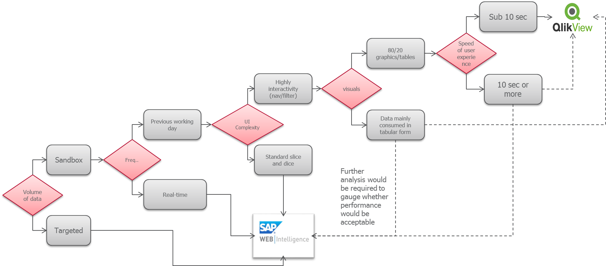
A nalysis
Analysis pages are more interactive, they help users explore their data and look for answers to questions they may have formed on the dashboard page. Analysis pages are where you come to spend more time and interact with the application on a deeper level to explore the data. Typically each page has a part of the business it is exploring or a specific technical objective
Do you need to slice, dice and change the scope of the data to find the answers you need
No more than 1000 rows being rendered within any selection criteria
Exploratory
On Refresh
Defined Set of Data

Slide 12
R eport
Reporting pages give the most granular information with lots of tabular data and should ultimately lead to action. It’s where a user can spend a lot of time sorting and filtering through the details. This is a large part of the cognition phase of perception
Do the users want to see tabular or columnar data as part of the solution
Sub 10 sec
Pre aggregated
Speed of user experience
Required as part of wider solution
Granularity
10 sec or more
On the fly
Scope
Line Level reporting
Type
Specified standalone Tabular/Columnar
Periodic

Slide 13

S elf-service
Self-service business intelligence is defined as end users designing and deploying their own reports and analyses within an approved and supported architecture and tools portfolio.
Do the users want to be able to interact with the source for data discovery
Charts, Infographics
Only data in the data model
Displayed as
Scope of data
Mainly Tabular, Columnar
Access to all EDF data

Slide 14
DAR Review Process

Slide 15
Evolving Process
During the infancy of the use of the bi tool decision tree it is recommended that a meeting be scheduled once the stage 1 approval from the Design Review Board has been received, with DRS team resource.
This will help ensure that any issues that arise can be addressed immediately and that any tweaks needed to the decision trees for scenarios that have not been covered can be captured

